Slide 1
Table of Contents
Theory of Change’s Narrative
Theory of Change Diagram
Mapping of Data Inputs to Inform Analysis

Slide 2
Problem
While considerable progress has been made in recent years at national levels on action to achieve UN’s Sustainable Development Goals (NDGS), the use of safety nuclear technology has not yet reach its potential as a mechanism to help countries to address key development priorities.

Slide 3
Constraints
Constraints that may prevent countries to implement nuclear technologies in favour of increasing productivity; ensuring safety and quality; improving control of pests in Food & Agriculture:
There is no staff left to operate equipment
There is no staff to implement technology
Lack of maintenance of equipment
Lack of funding for operational inputs
Research priorities shifted
Unsuccessful results in technology application
Lack of TCP support

Slide 4
Objective
The technical cooperation programme is the IAEA’s primary mechanism for transferring nuclear technology to Member States, helping them to address key development priorities.
The programme also helps Member States to identify and meet future energy needs, and assists in improving radiation safety and nuclear security worldwide, including through the provision of legislative assistance.
The main objective of the TCP is to bring benefits of nuclear power to the world and to help Member States to enjoy the benefits of the peaceful uses of nuclear sciences and technologies to promote sustainable development and to make a concrete difference to the lives of millions of people across the world.
Improving nutrition.
Growing stronger crops
Increasing farming efficiency,
Managing insect pests,
Examining animal health

Slide 5
Solution/inputs
IAEA has designed the TCP to provide technical assistance with the aim of facilitating the use of nuclear technologies to thet the best of nuclear sciences while strenghteining radiation safety for the protection of people and the environment.
TCP’s delivery has been designed around 3 main components:
Professional development : National and regional training courses, sharing regional expertise.
Global networks: Access to data, IAEA guidelines/codes of practice, procedures and best practices.
Establishment of new technologies: Equipment, Service, Access to laboratories/education centres.
Their utilisation within the programme is premised on the fact that all three inputs interact with and inform the other, rather than operating independently of each other

Slide 6
Outputs
An output can be described as the deliverable or product that is produced or provided by a series of inputs and activities that an intervention supports. As such, an output is within the direct control of an intervention, is provided to the intervention’s direct beneficiaries or recipients, and is expected to form the basis on
which the desired change will occur.
Supported professionalization to enhance quality of procedure/service/programme
Participation in global networks.
Shared new protocols/ technical guidelines
Access to infrastructure of institution / Laboratories/ Educational centres
Introduce new technologies

Slide 7
Intermediate Outcomes (Effectiveness)
An intermediate outcome provides an interim indication of initial uptake by programme stakeholders. The logic of the intermediate outcome is that programme-supported outputs should be adopted or taken up by the stakeholders that work most directly with the programme, who are then responsible for using or implementing those outputs to achieve their intended purpose.
*Introduce new technologies
* Develop regulatory frameworks / new technical guidelines
* Produce data to inform policies
* Upgraded institutions/laboratories/educational/centers
* Curricula in new professions

Slide 8
Outcomes (Sustainability)
The outcome seek to go a step further by identifying the implementation or use of programme-supported outputs as its change mechanism. If the programme’s adopted outputs are effectively implemented by its beneficiary stakeholders, we articulate this as enhanced and sustained action.
Increased use of a new technology/tool or technique in a specific sector
Adoption of Plans/Policies/Programmes or Technical Standards by National Entities
Use of data to inform regulatory
Creation of new Institution/ Laboratory/Education Centres
New profession recognized/ More professionals in the workforce

Slide 9




Impact (relevance)
Increase crop productivity and resilience to climate change in agriculture.
Increase livestock productivity
Ensure food safety and quality protection of consumers to facilitate international trade
Improve surveillance, detection ,and control of inspects pests of Agriculutral Veterinary importance
Improved agricultural soil, water and crop nutrition management.

Slide 10
TCP Theory of Change:
Impact (relevance)
Intermediate Outcomes
(EFFECTIVENESS)
Needs
Increase crop productivity and resilience to climate change in agriculture.
That may prevent countries to implement nuclear technologies in favour of increasing productivity; ensuring safety and quality; improving control of pests in Food & Agriculture:
Indication of initial uptake by programme stakeholders
Increase livestock productivity
Inputs
Ensure food safety and quality protection of consumers to facilitate international trade
*Introduce new technologies
Professional development
New technologies
Global networks
Improve surveillance, detection ,and control of inspects pests of Agriculutral Veterinary importance
There is no staff left to operate equipment
Improve agricultural soil, water and crop nutrition management
* Develop regulatory frameworks / new technical guidelines
Outcomes
(SUSTAINABILITY)
There is no staff to implement technology
MEMBER STATES
If the programme’s adopted outputs are effectively implemented by its beneficiary stakeholders, we articulate this as enhanced and sustained action.
* Produce data to inform policies
Lack of maintenance of equipment
Increased use of a new technology/tool or technique in a specific sector
Adoption of Plans/Policies/Programmes or Technical Standards by National Entities
Use of data to inform regulatory
Creation of new Institution/ Laboratory/Education Centres
New profession recognized/ More professionals in the workforce
Lack of funding for operational inputs
* Upgraded institutions/laboratories/educational/centers
TCP’s delivery has been designed around 3 main components:
Professional development : National and regional training courses, sharing regional expertise.
Global networks: Access to data, IAEA guidelines/codes of practice, procedures and best practices.
Establishment of new technologies: Equipment, Service, Access to laboratories/education centres.
Their utilisation within the programme is premised on the fact that all three inputs interact with and inform the other, rather than operating independently of each other
Research priorities shift
* Curricula in new professions
Unsuccessful results in technology application

Slide 11
Data to inform the analysis
Constraints
There is no staff left to operate equipment
From CP survey:
Status of development when your institution collaborated with the TCP in %start year%?
Status of development at the moment (2023)
In your opinion which are the reasons that best explain the shrink of the level of development?
In your opinion, what are the aspects that may help ensuring sustainability of the achievements reached with IAEA TCP support?
There is no staff to implement technology
Lack of maintenance of equipment
Lack of funding for operational inputs
Research priorities shift
Unsuccessful results in technology application

Slide 12
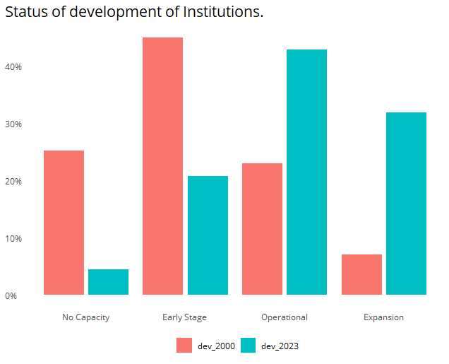
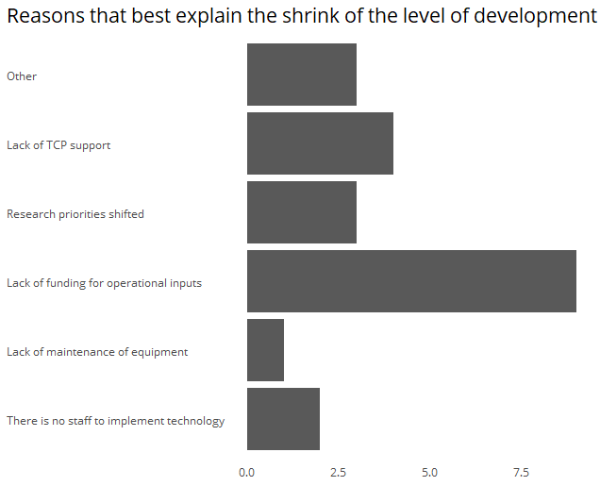
Example of data from CP

Slide 13
Data to inform the analysis
From CP survey:
Based on your knowledge, HOW did the TCP contribute to the development of this %FOA%?
What has been the most effective input given by the TCP to support your institution?
What has been the most effective input given by the TCP to support <i>%foas%</i> in your institution?
Inputs
Professional development
New technologies
Global networks
From NLO 1 (Regional Coop Agreements):
What has been the value added by participating in activities led by the Regional Cooperation Agreements in the context of the TC Programme?

Slide 14
Data to inform the analysis
Intermediate Outcomes
Indication of initial uptake by programme stakeholders
From CP survey:
In your opinion, has the support of the TCP consolidated into any of the following?
*Introduce new technologies
* Develop regulatory frameworks / new technical guidelines
* From NLO 1 (Effectiveness):
Please indicate the estimated time range when the improvements introduced by TC programme in each area were achieved in your country.
* Produce data to inform policies
* Upgraded institutions/laboratories/educational/centers
* Curricula in new professions

Slide 15
Pathway of results
Intermediate Outcomes
Indication of initial uptake by programme stakeholders
*Introduce new technologies
Increased use of a new technology/tool or technique in a specific sector
Adoption of Plans/Policies/Programmes or Technical Standards by National Entities
Use of data to inform regulatory
Creation of new Institution/ Laboratory/Education Centres
New profession recognized/ More professionals in the workforce
* Develop regulatory frameworks / new technical guidelines
* Produce data to inform policies
* Upgraded institutions/laboratories/educational/centers
* Curricula in new professions

Slide 16
Data to inform the analysis
From CP survey:
TO THE BEST OF YOUR KNOWLEDGE, did any of the following outcomes occurred as a result of the support given by the TCP-IAEA?
Outcomes
If the programme’s adopted outputs are effectively implemented by its beneficiary stakeholders, we articulate this as enhanced and sustained action.
Standardization and procedures in alignment with international practices applied
Development of national or regional education programmes
*Increased use of a new technology/tool or technique in a specific sector
*Adoption of Plans/Policies/Programmes or Technical Standards by National Entities
National programmes promoting new technology
*Creation of new Institution/ Laboratory/Education Centres
Improve Technical Standards in a specific sector/entities
*New profession recognized/ More professionals in the workforce
*Use of data to inform regulatory
From NLO 1 (Sustainability):
Please indicate the estimated period when the improvements, introduced by the TC programme, have produced tangible results in the country.
Adoption of Plans/Policies/Programmes or Technical Standards by National Entities

Slide 17
Data to inform the analysis
From CP survey:
In your opinion, which of the following long-term impacts resulted from the support given by the TCP-IAEA on the thematic area <i>%theme%</i> in %country%?
Impact
Increase crop productivity and resilience to climate change in agriculture.
Increase livestock productivity
Ensure food safety and quality protection of consumers to facilitate international trade
From NLO1 (Relevance):
How would you define the degree to which the TC programme has contributed in achieving results in each area of support in your country?
Improve surveillance, detection ,and control of inspects pests of Agriculutral Veterinary importance
Improve agricultural soil, water and crop nutrition management

Slide 18
Ladder of development
Reached initial capacities..................................................................................1
Reached mastery of the services/procedure/programmes........................................................2
Became leader nationally (e.g. provides training nationally) with respect to services/procedure/programme...3
Became leader regionally (e.g. provides training regionally) with respect to services/procedure/programme...4
EARLY STAGE of the services/procedure/programmes....2
Services/procedure/programme OPERATIONAL............3
Services/procedure/programme undergoing EXPANSION...4

Slide 19

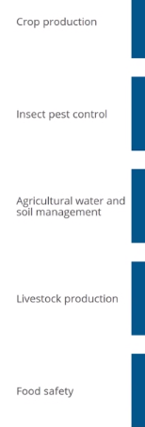
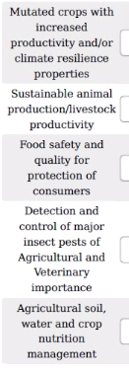
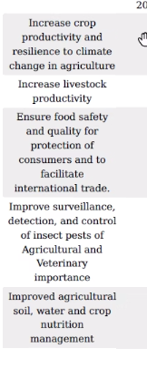

NUCLEAR BASED TECHNOLOGIES TRANSFERRED IN THE FIELDS OF
RESULT IN
CONTRIBUTE TO
AND BY THE FOLLOWING INSTRUMENTS

Slide 20
What is the challenge?
FOAs have changed names over time.
FOAs are named differently across data collection tools: Sometimes, questions were phrased referring to a technology or to an improvement.
If the data is to be comparable across instruments, and if the analysis is expected to conduct aggregations, a mapping should be conducted.
*Remember. There are 4 main data sources used for the analysis:
Historical list of projects supported
NLO 1
NLO 2
CP

Slide 21
Result from data mapping
33 FOAs → 22 Improvements → 16 impacts

Slide 22
What is the challenge?
FOAs have changed names over time.
FOAs are named differently across data collection tools: Sometimes, questions were phrased referring to a technology or to an improvement.
If the data is to be comparable across instruments, and if the analysis is expected to conduct aggregations, a mapping should be conducted.
*Remember. There are 4 main data sources used for the analysis:
Historical list of projects supported
NLO 1
NLO 2
CP

